Slide 1
Controlling a computer
Andrei Petrovski
( a.petrovski@rgu.ac.uk)
CM530– System Programming and Security

Slide 2
Overview
Fundamentals of computer hardware
General strategies for access control
Buffer overflow attacks on computers
Access control mechanisms in computers
Security planning: policy and implementation
Protecting processes
2
School of Computing Science and DM, RGU

Slide 3
Computers and programs

Slide 4
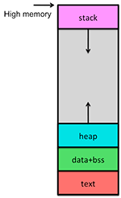
Organising RAM into ‘sections’
Control Sections
Contain instructions to execute
Contain unchanging data
Data Sections
Contain variables that change
data with assigned values + unassigned (block started by symbol (BSS))
Contain “free form” RAM
Buffers, Stacks

Slide 5
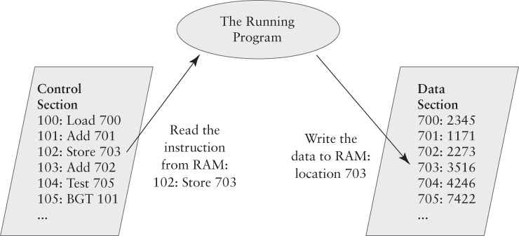
Control and Data Sections

Slide 6
Programs and Processes

Slide 7
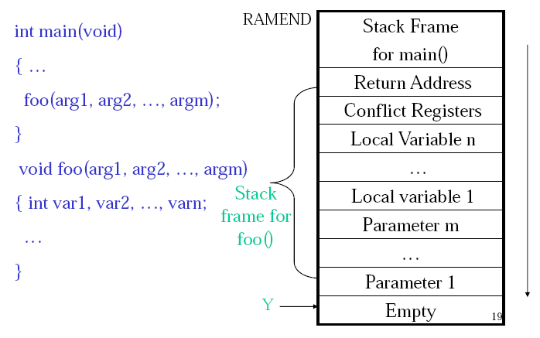
One function calls another function
We save the program counter in the “calling function”
We execute the instructions in the “called function”
At the end of the “called function” we restore the program counter
This returns the CPU to where the “calling function” left off

Slide 8
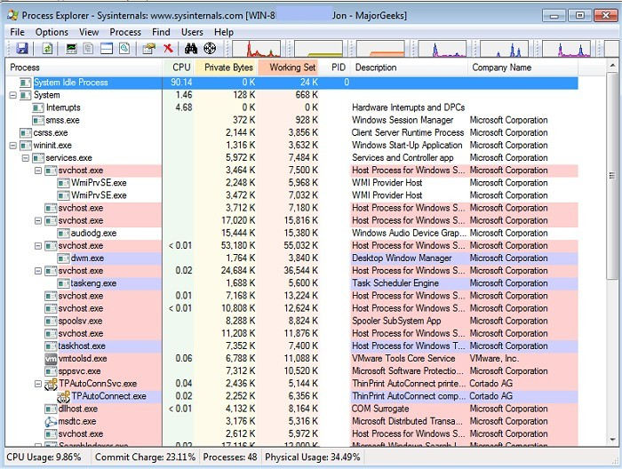
Processes
A program is a group of instructions
A process is a running program
Its PC is, or can be, changing
It has some RAM with instructions and data
Windows Example
Run two command shells
One program, two processes
Looking at processes with the Task Manager
List Applications; List Processes

Slide 9
Keeping processes separate

Slide 10
Keeping Processes Separate
Relies on hardware and software
Hardware: two CPU features
Program Modes
RAM Protection – island model through page table
Software: Operating System features
Program dispatcher
Memory manager
User identities

Slide 11
Operating System Protections
Originally only available on mainframes and higher-end minicomputer OSes (Unix, VMS)
Adapted to desktop OSes during 1990s
OS Security Features
Processes must take turns (“dispatching”)
Processes are assigned different parts of RAM
Processes cannot damage other areas of RAM
User-oriented interface and access controls
Sharing data

Slide 12
Access Matrix
Control or Data Section | Process #1 | Process #2 | Operating System
Control Section | R- | R- | RW
Process #1 Data Section | RW | -- | RW
Process #2 Data Section | -- | RW | RW
A way to specify access permissions
Rows for resources or RAM
Columns for active entities or processes

Slide 13
System Security landscape

Slide 14
Making Security Decisions
Rule-based decisions:
Dictated by external circumstances or widely accepted guidelines
Relativistic decisions:
Try to outdo others who are faced with similar security problems
Requirements-based decisions:
Based on a systematic analysis of the security situation
First two groups of decisions often arise from security checklists; the last one uses security requirements to choose among competing checklists.
“Security is the property that a system behaves as expected”, G. Spafford

Slide 15
Principles of System Security
First basic principle: Continuous Improvement
The security process never ends at the final step – any step in the process may suggest a change that can improve the final result by returning to earlier steps in the cycle (planning – trade-off analysis – verification - iteration).
Second basic principle: Least privilege
Give people as few privileges as possible regarding the asset to be protected
Third basic principle: Defense in Depth
Developing layered defense, where the innermost domain has the most restricted access, surrounded by other domains will fewer and fewer restrictions.

Slide 16
Constructing a Security Plan
The Security Plan is a detailed assessment
A high-level analysis is an overview
The Plan contains the details
List of Assets
Full risk assessment
Prioritized list of risks
Security Policy – a list of required defenses
Implementation – a list of security controls

Slide 17
Policy and Implementation
Policy identifies what we want for protection
Implementation says what we get
How we do it
Take the prioritized list of risks
For each risk, identify defenses against it
Write a policy statement for each defense
Each statement defends against 1 or more risks
For each policy statement, pick security controls
Each control addresses 1 or more policy statements

Slide 18
Risk of Back Door on the Laptop
The risk is usually an Internet-borne risk
stand-alone tower computer doesn’t face it
Protect the laptop with up-to-date software
The laptop shall regularly check for system security updates and install those updates.
The laptop shall contain and use antivirus software.

Slide 19
Security Plan: Process Protection
How does the OS protect processes?
Goals:
Processes share the CPU
Processes may share control sections
Processes don’t share RAM except by request
Risks:
A process monopolizes the CPU
A process reads or writes RAM that it shouldn’t

Slide 20
Policy and Implementation
Six policy statements
Specifies security to be arranged by the dispatcher
Specifies when things should happen
Security Controls
All are functional controls provided by software
Some are steps in the dispatcher procedure
Others are features of how the OS ensures that the dispatcher is run or how security is applied

